Slide 1
Cysteine Prediction in Pea Cultivars Using Raman Spectroscopy and Machine Learning Week-2 Revised
Priyanshu Mittal
June 17, 2026

Slide 2
What We Did This Week?
Completed a second round of literature review (6 papers)
Trained and optimised a PLSR model as the baseline
Tested 8 different preprocessing combinations
Compared two validation strategies: 80/20 split and Leave-One-Cultivar-Out (LOCOCV)

Slide 3
Literature Review Summary
Paper | Method | Sample Type & Size | Novelty | Training Procedure | Evaluation Procedure
Wu et al. | PFCOVSC (Preprocessing Fusion + fCovsel + PLS) | Wheat (415 train, 108 test), Meat (172 train, 43 test), Tablet (210 train, 100 test) | First method to fuse multiple preprocessing blocks into one matrix and perform variable selection across all blocks simultaneously; faster and order-independent compared with SPORT and PROSAC | Ten preprocessing blocks fused into a single matrix. fCovsel selected 40 informative variables. PLS model built on selected variables. Optimal latent variables determined using leave-one-out cross validation. | Independent test set evaluation using RMSEC and RMSEP. Compared against single-block PLS, SPORT and PROSAC.
Liu et al. | CNN, RNN, Autoencoder, GAN, Transfer Learning, Contrastive Learning (Review) | Multiple spectroscopy datasets across Raman, NIR, IR and Mass Spectrometry | Comprehensive review of deep learning in spectral analysis. Highlights transfer learning, data augmentation, self-supervised learning and generative approaches for small spectral datasets. | Summarises training approaches used across published studies, including supervised, transfer learning and self-supervised frameworks. | Reviews published performance and applications across multiple spectroscopy domains rather than conducting experiments.
Notes:
Preprocessing ensembles combining multiple preprocessing methods (SNV + MSC + derivatives) into one fused matrix extracts complementary information no single method captures
Autoencoder + regression unsupervised spectral feature extraction followed by regression, handles small datasets better than end-to-end supervised models
Transfer Learning — pretrain CNN on large spectral dataset, fine-tune on our 20-cultivar dataset, directly addresses the small dataset limitation
XGBoost as preprocessing transforms spectral data into binary feature vectors before regression, shown to outperform SNV/MSC/derivatives on Raman data
Gaussian Process Regression (GPR) provides uncertainty estimates per prediction, particularly useful under LOCO where unseen cultivars may produce unreliable results
General Deep Learning Model (Pea-specific) predicts and classifies pea protein content simultaneously using Vis-NIR spectroscopy, directly applicable to our pea cultivar dataset
Deep Neural Network (DNN) five-layer fully connected network, outperformed both PLSR and SVR for protein prediction through NIR spectroscopy

Slide 4
Literature Review Summary
Paper | Method | Sample Type & Size | Novelty | Training Procedure | Evaluation Procedure
Wang et al. | XGBoost-assisted Linear Regression (X-LR) and MLP (X-MLP) | Raman spectra of glucose, glycerol and ethanol mixtures; 40 samples split 6:2:2 | First use of XGBoost as a spectral preprocessing technique. Converts spectra into binary feature vectors through leaf-node encoding and replaces traditional preprocessing. | XGBoost trained on raw spectra to generate binary features. LR and MLP trained on transformed features. Hyperparameters optimised using Optuna with 100 iterations. | Evaluated using R², RMSEC and RMSEP on held-out test data. Compared against eight traditional preprocessing methods including SNV, MSC and Savitzky-Golay derivatives.
Chen et al. | Gaussian Process Regression (GPR) compared with PLSR and SIMCA | NIR spectra of mangoes; 9,711 hard-green samples and 1,980 ripe out-of-distribution samples; 7:3 split | First application of GPR predictive variance as a confidence measure to identify out-of-distribution samples and flag unreliable predictions. | GPR and PLSR trained on hard-green mango samples. Kennard-Stone algorithm used for data splitting. Covariance function optimised during model fitting. | Evaluated on in-distribution, out-of-distribution and mixed test sets using RMSE and R². GPR variance threshold used to remove uncertain predictions.
Notes:
Preprocessing ensembles combining multiple preprocessing methods (SNV + MSC + derivatives) into one fused matrix extracts complementary information no single method captures
Autoencoder + regression unsupervised spectral feature extraction followed by regression, handles small datasets better than end-to-end supervised models
Transfer Learning — pretrain CNN on large spectral dataset, fine-tune on our 20-cultivar dataset, directly addresses the small dataset limitation
XGBoost as preprocessing transforms spectral data into binary feature vectors before regression, shown to outperform SNV/MSC/derivatives on Raman data
Gaussian Process Regression (GPR) provides uncertainty estimates per prediction, particularly useful under LOCO where unseen cultivars may produce unreliable results
General Deep Learning Model (Pea-specific) predicts and classifies pea protein content simultaneously using Vis-NIR spectroscopy, directly applicable to our pea cultivar dataset
Deep Neural Network (DNN) five-layer fully connected network, outperformed both PLSR and SVR for protein prediction through NIR spectroscopy

Slide 5
Literature Review Summary
Paper | Method | Sample Type & Size | Novelty | Training Procedure | Evaluation Procedure
Xiao et al. | General Deep Learning Model for simultaneous regression and classification | Vis-NIR spectra of pea samples from multiple cultivars and growing environments | First deep learning framework developed specifically for pea protein prediction while simultaneously classifying cultivars within a single model. | Model trained using Vis-NIR spectra and laboratory-measured protein content. Designed to generalise across cultivars and environmental conditions. | Evaluated using RMSE and R² for protein prediction and classification accuracy for cultivar identification. Tested on unseen cultivars.
Yang et al. | Deep Neural Network (DNN) compared with PLSR and SVR | 1,800 paddy rice spectra and 1,200 brown rice spectra collected from 950–2200 nm | One of the few studies applying deep learning for non-destructive protein prediction in paddy rice. Demonstrated that DNN outperformed traditional PLSR and SVR models. | Five-hidden-layer DNN trained using NIR spectra and laboratory-measured protein content. Multiple preprocessing methods evaluated. Data split 70:30 with 10-fold cross validation. Batch Normalization and ReLU activation functions used. | Evaluated using R² and RMSE on independent prediction datasets. Best DNN achieved Rp² = 0.972 (RMSEP = 0.048) for paddy rice and Rp² = 0.987 (RMSEP = 0.033) for brown rice, outperforming PLSR and SVR.
Notes:
Preprocessing ensembles combining multiple preprocessing methods (SNV + MSC + derivatives) into one fused matrix extracts complementary information no single method captures
Autoencoder + regression unsupervised spectral feature extraction followed by regression, handles small datasets better than end-to-end supervised models
Transfer Learning — pretrain CNN on large spectral dataset, fine-tune on our 20-cultivar dataset, directly addresses the small dataset limitation
XGBoost as preprocessing transforms spectral data into binary feature vectors before regression, shown to outperform SNV/MSC/derivatives on Raman data
Gaussian Process Regression (GPR) provides uncertainty estimates per prediction, particularly useful under LOCO where unseen cultivars may produce unreliable results
General Deep Learning Model (Pea-specific) predicts and classifies pea protein content simultaneously using Vis-NIR spectroscopy, directly applicable to our pea cultivar dataset
Deep Neural Network (DNN) five-layer fully connected network, outperformed both PLSR and SVR for protein prediction through NIR spectroscopy

Slide 6
Dataset Overview - Updated
20 pea cultivars × 324 spectra = 6,480 spectra total
1,530 usable spectral data points per spectrum
Raman shift range: 97.8 – 3,361.7 cm⁻¹
Cysteine range: 0.312 – 0.373 g/100g (spread of only 0.061)
Labels: one cysteine value per cultivar shared across all 324 spectra
Redbat 88 dataset updated and confirmed at 324 spectra

Slide 7
PLSR – Partial Least Squares Regression
Partial least squares regression (PLS regression) is a statistical technique that shares similarities with principal components regression.
Instead of identifying hyperplanes of maximum variance between the response and independent variables, PLS regression constructs a linear regression model by projecting both the predicted and observable variables into a new space.
This characteristic of projecting data to new spaces classifies PLS methods as bilinear factor models.
Partial least squares discriminant analysis (PLS-DA) is a specific variant used when the response variable (Y) is categorical

Slide 8
How does it works?
Our spectrum has 1,530 features per sample. But we only have 20 unique cysteine values. If we feed all 1,530 features directly into a model, it gets confused as it have too many variables, too few labels. We need to compress the data first.
What PLSR does?
PLSR compresses 1,530 spectral features into a small number of new variables called latent components.
What makes PLSR special:
PLSR compresses in a way that maximises the relationship between the spectrum and cysteine concentration simultaneously. It finds the directions in spectral space that best explain cysteine variation.

Slide 9
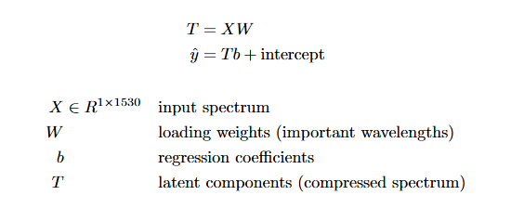
How it Works?
The math simply explained:
How we optimized it?
We tested 1 to 40 components using 5-fold cross validation.
Too few components = underfitting.
Too many = overfitting.
The best spot was 18 components — after that, RMSE started rising again.

Slide 10
Step by Step in Coding
Build X and y:
Preprocess
X = matrix of all spectra # shape: (6480, 1530)
y = cysteine values # shape: (6480,)
Each row in X = one spectrum
Each value in y = cysteine label for that spectrum
SG Smoothing : removes noise from each spectrum
SNV : makes every spectrum have mean=0, std=1
: fixes the intensity scaling problem

Slide 11
Step by Step in Coding
Split Data:
Train PLSR:
80/20 Split:
Training set = 5,184 spectra (used to fit the model)
Test set = 1,296 spectra (used to evaluate)
LOCOCV:
Hold out all 324 spectra from one cultivar
Train on remaining 19 cultivars
Predict held-out cultivar
Repeat 20 times
plsr = PLSRegression(n_components=18)
plsr.fit(X_train, y_train)
# The model finds 18 latent components that best explain cysteine variation

Slide 12
Step by Step in Coding
Predict and Evaluate
y_pred = plsr.predict(X_test)
RMSE = average prediction error in g/100g
R² = how much variance the model explains (1.0 = perfect)
RPD = std of y / RMSE (> 2.0 = acceptable, > 3.0 = good)

Slide 13
Preprocessing Pipeline
Raw Spectrum
SG Smoothing
SNV
PLSR
Prediction
Step 1 — Savitzky-Golay Smoothing (applied to all) Reduces high-frequency noise while preserving peak shape.
Window = 11, polynomial order = 3.
Step 2 — Normalisation/Correction (varied)
Eight combinations tested: SG + SNV, SG + MSC, SG + 1st Derivative, SG + 2nd Derivative, SG + SNV + 1st Der, SG + SNV + 2nd Der, SG + MSC + 1st Der and SG + MSC + 2nd Der
Notes:
SG + SNV: Removes intensity scaling differences and normalizes spectra.
SG + MSC: Corrects multiplicative scatter effects caused by particle size or light scattering.
SG + 1st Derivative: Removes baseline shifts and enhances peak resolution.
SG + 2nd Derivative: Provides stronger baseline correction
SG + SNV + 1st Derivative: Normalizes spectra and enhances peak features while reducing baseline effects.
SG + SNV + 2nd Derivative: Normalizes spectra and provides stronger enhancement of spectral features with improved baseline removal.
SG + MSC + 1st Derivative: Corrects scatter effects and enhances peak resolution.
SG + MSC + 2nd Derivative: Corrects scatter effects and provides stronger baseline removal and peak separation.

Slide 14
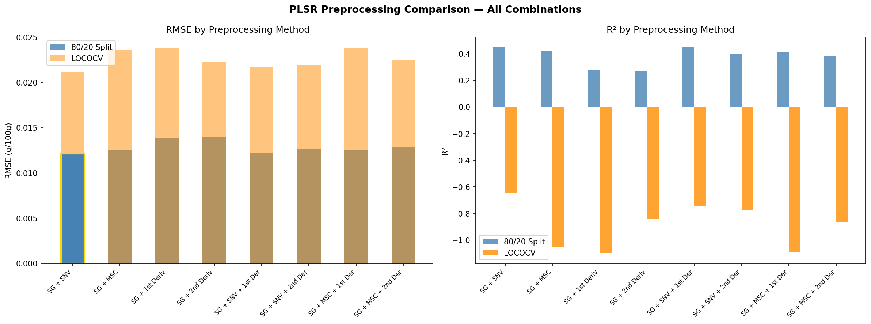
Preprocessing Optimization Results

Slide 15
Preprocessing Method | Best Components | 80/20 RMSE | 80/20 R² | 80/20 RPD | LOCO RMSE | LOCO R² | LOCO RPD
SG + SNV | 18 | 0.0122 | 0.4476 | 1.3455 | 0.0211 | -0.6481 | 0.7790
SG + MSC | 18 | 0.0125 | 0.4182 | 1.3111 | 0.0236 | -1.0547 | 0.6976
SG + 1st Derivative | 30 | 0.0139 | 0.2811 | 1.1794 | 0.0238 | -1.0987 | 0.6903
SG + 2nd Derivative | 25 | 0.0140 | 0.2730 | 1.1729 | 0.0223 | -0.8413 | 0.7369
SG + SNV + 1st Derivative | 30 | 0.0122 | 0.4470 | 1.3447 | 0.0217 | -0.7433 | 0.7574
SG + SNV + 2nd Derivative | 30 | 0.0127 | 0.3989 | 1.2898 | 0.0219 | -0.7762 | 0.7503
SG + MSC + 1st Derivative | 28 | 0.0125 | 0.4154 | 1.3079 | 0.0238 | -1.0876 | 0.6921
SG + MSC + 2nd Derivative | 27 | 0.0129 | 0.3832 | 1.2733 | 0.0225 | -0.8643 | 0.7324
Notes:
Among all preprocessing combinations,
SG + SNV produced the strongest overall performance, achieving the highest R² and RPD values and the lowest RMSE for both the 80/20 split and LOCO validation.
Derivative hurts performance: adding 1st or 2nd derivative made results worse across all combinations. Likely because the cysteine signal is very subtle and derivatives amplify noise alongside real signal
MSC performs similarly to SNV but slightly worse
The gap between 80/20 and LOCO is consistent across all 8 methods, no preprocessing combination closes it. This indicates the limitation is the model itself, not the preprocessing

Slide 16
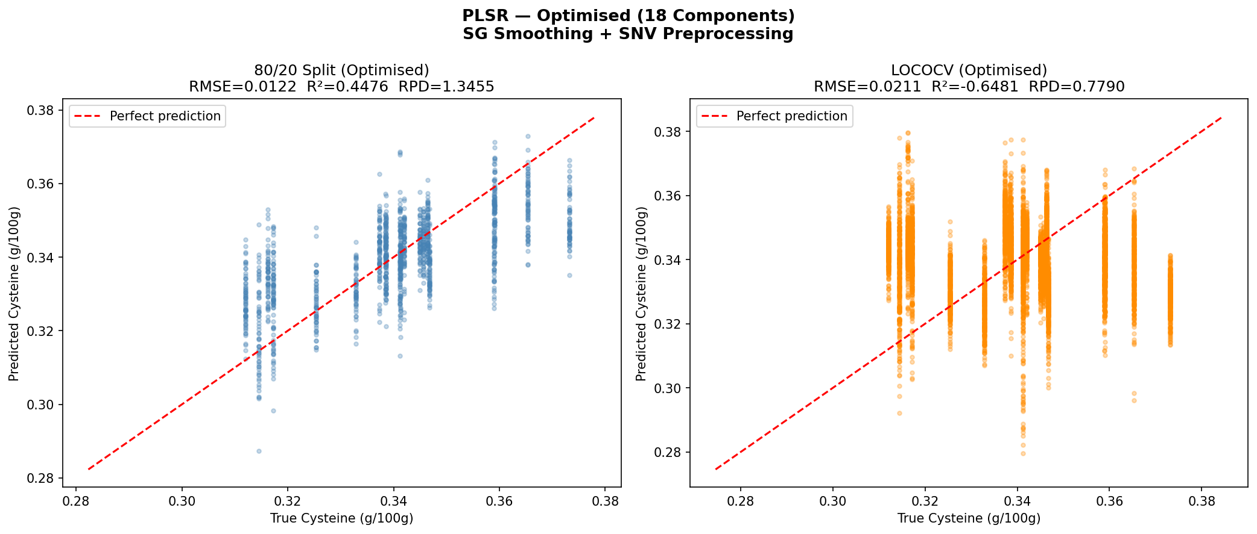
PLSR Results
 | 80/20 Split | LOCOCV
RMSE | 0.0122 | 0.0211
R² | 0.4476 | -0.6481
RPD | 1.3455 | 0.7790
Notes:
80/20 Split (R² = 0.45, RPD = 1.35)
Moderate performance
RPD < 2.0 is not sufficient for screening applications
LOCOCV (R² = -0.65, RPD = 0.78)
Negative R² model predicts global mean (~0.34) for every sample

Slide 17
80/20 vs LOCOCV
80/20 Split | LOCOCV
Model sees all cultivars during training Artificially inflated performance | Model tested on completely unseen cultivar Exposes true generalisation ability PLSR predicts global mean (~0.34) for every unseen cultivar

Slide 18
Derived vs Published Results
 | Research Paper | Derived Paper
Preprocessing | SG + ModPoly + Min-Max | SG + SNV
Components | 25 | 18
LOCO RMSE | 0.021 | 0.0211
Within-cultivar R² | 0.626 | 0.4476

Slide 19
Conclusion
Best preprocessing: SG + SNV outperformed all 8 combinations on both validation strategies
PLSR baseline: Moderate performance on 80/20 (R²=0.45) but poor generalisation under LOCO (R²=-0.65)
Key challenge: Narrow cysteine range (0.061 g/100g) and high within-cultivar variability limit PLSR generalisation

